Slide 1

Use data linkage to support AMR research through a whole-systems approach
Nina Zhu
CAMO-Net Data Theme Meeting, Kampala, Uganda
06 June 2024

Slide 2
Overview
Welcome
Data linkage: why, how, what to achieve within CAMO-Net
Ongoing work in CAMO-Net UK
Activity
Notes:
; including electronic patient records and hospital bed occupancy

Slide 3
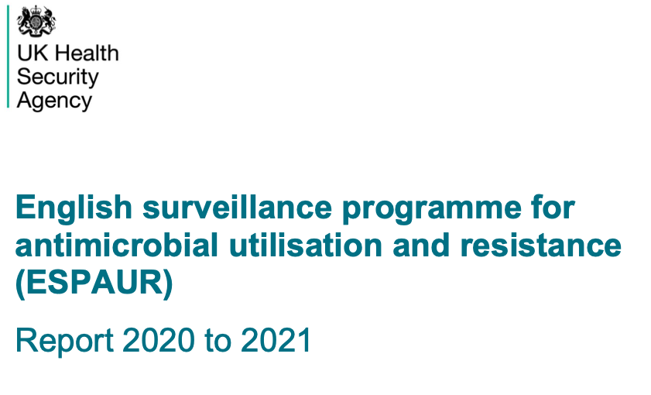

About me
Biomedical engineering
Public health
Epidemiology
Health economics

Slide 4
Overview
Welcome
Data linkage: why, how, what to achieve within CAMO-Net
Ongoing work in CAMO-Net UK
Activity
Notes:
; including electronic patient records and hospital bed occupancy

Slide 5
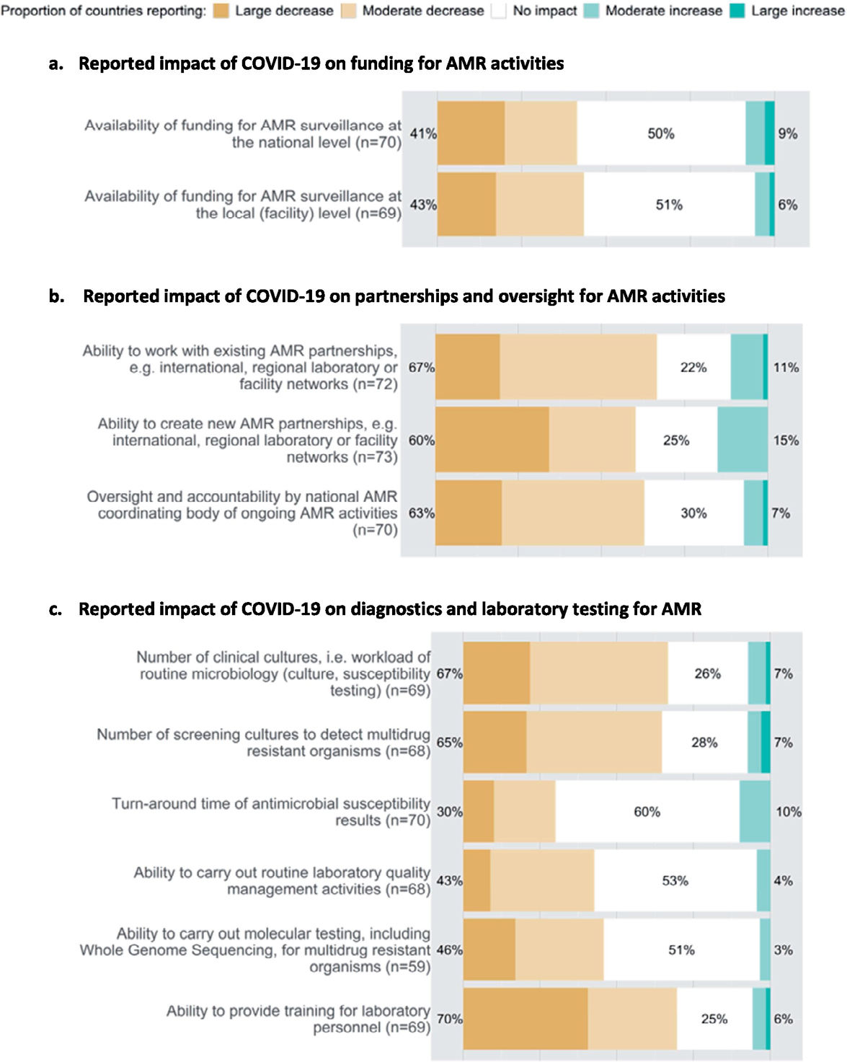
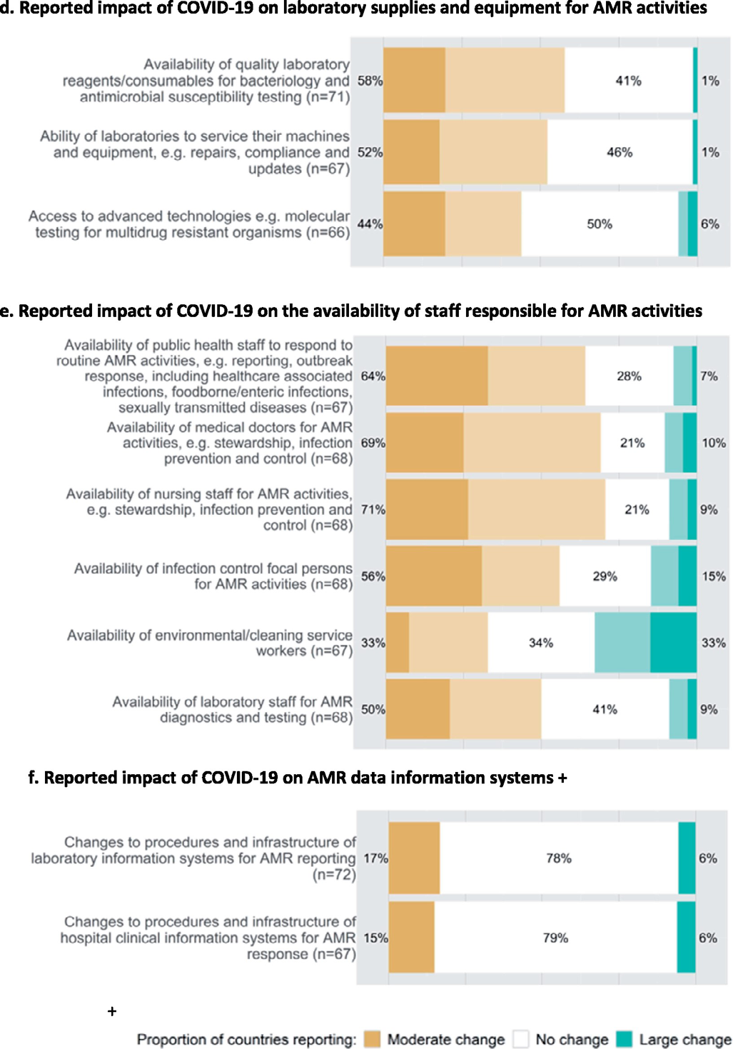
Why
Economic
Feasible
Realistic
Ethical
Resilient
Zhu, CID, 2021; Tomczyk, 2021

Slide 6
What
PID: 0000001
Date: 05-06-2024
Organism: 80166006 Streptococcus pyogenes (organism)
Individual
PID: 0000001
Date: 06-06-2024
Observation: 267102003 Sore throat (finding)
Post code: W12 xx
Ecological
Postcode: W12 0NN
LOSA (lower layer super output area): E01001876
Multiple index of deprivation: 2
Deprivation rank: 5,098 (out of 32,844)

Slide 7
What
Individual
Deterministic:
Exact one-to-one character matching using unique identifier universal across datasets
Probabilistic:
Matching cases / data entries based on multiple non-unique variables.
A hierarchy of variables can be defined based on data quality of each variable (e.g., admission date > DOB > gender > postcode).
A distance between two datasets can be calculated between complete agreement and complete disagreement.

Slide 8
What
De-duplication: define rule to de-duplicate when the data rows are not identical (e.g., the worst-case scenario is taken when there are multiple susceptibility test results for one isolate).
AST test level: R + I + I = R, I + S = I, I + undetermined = I
Patient level: (common practice) multiple blood specimens were taken on the same date these were combined and account for 1 test only, subsequent patient specimens were excluded
Isolate level: to determine whether it is a contaminant (blood commensals)
Convert to infection episode (case): based on pre-defined time window, determined by incubation period
Common bacteria: 14 days (static / rolling)
SARS-CoV-2: 60 days

Slide 9
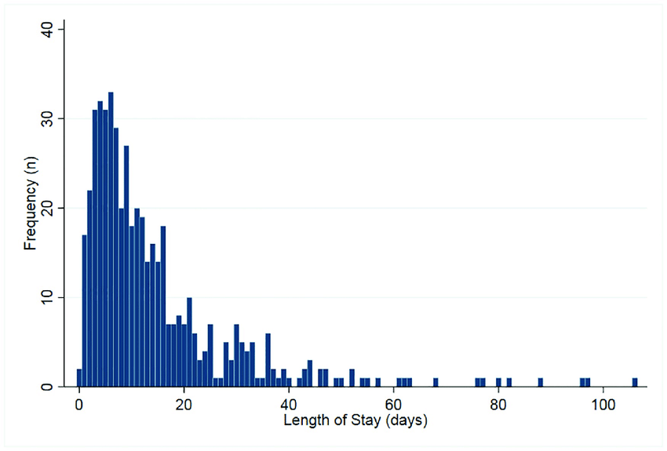
What
Imputation: replace missing values with substituted values (based on distribution). Whether there is a pattern of missing data might indicate surveillance gaps.
Almeida, PLOS One, 2019

Slide 10
What
Denominator: essential when estimating prevalence and incidence, also indicates capacity / interruption of service
Zhu, CID, 2021

Slide 11


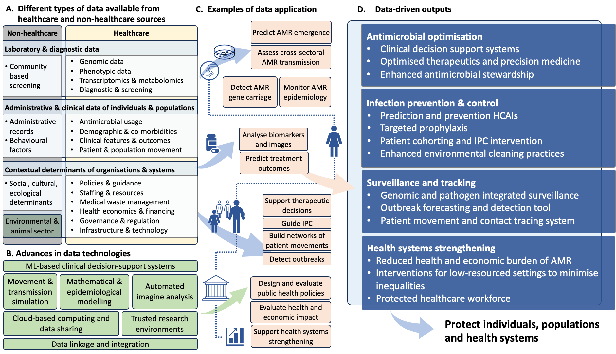
Cocker, 2024, Nature Reviews Microbiology in press

Slide 12
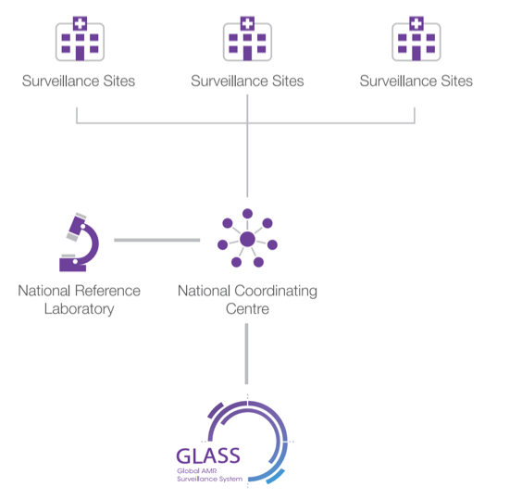
Specimen-based AMR surveillance
Key issues:
Metadata: minimal requirement (species, AST, type of specimen); additional: demographic, epidemiological variables
Microbiological investigation vs routine surveillance
Isolate-based (positives only) vs specimen-based (with denominators)
WHO GLASS, 2014
Notes:
; including electronic patient records and hospital bed occupancy

Slide 13
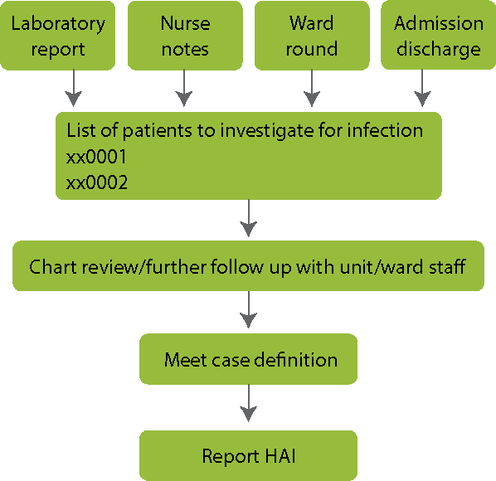
Case-based HCAI surveillance
Key issues:
Metadata: patient demographic, device / procedures
Denominators: number of patients, patient-days, device-days, and procedures
Reporting: incidence vs prevalence
Risk stratification
Case identified with or without individual review
Review | No review
IPC workload – disruption Delay / missed in reporting | Can be retrospectively done with routine data but with limited validity
Risk factors / risk stratifications Treatment and outcomes
University of Washington IPC training
Notes:
; including electronic patient records and hospital bed occupancy

Slide 14
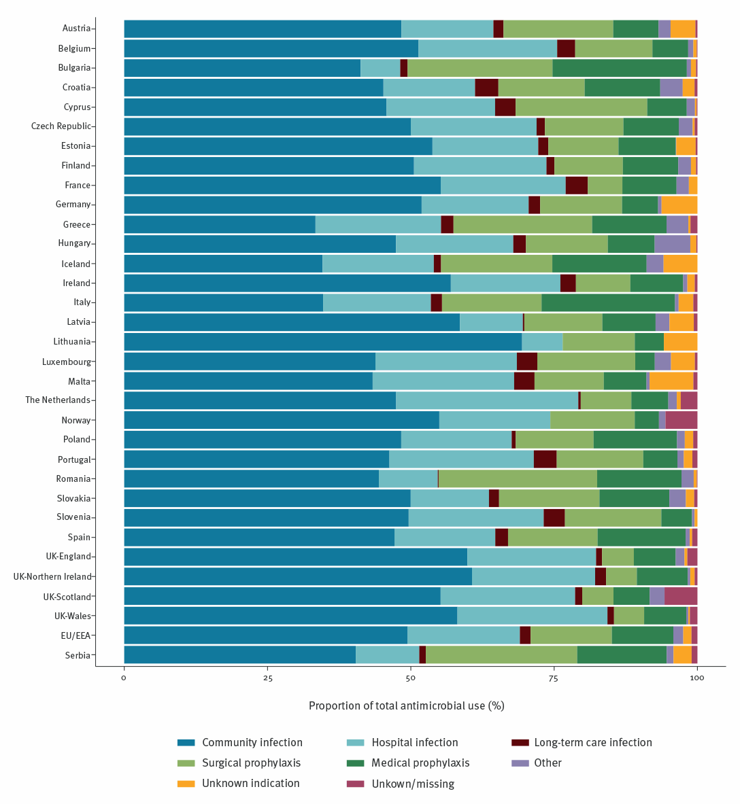
AMU surveillance
Key issues:
Prescribing indicators relying on point-prevalence surveys
Prescribing vs dispensing
Over-the-counter / online purchase
Data from health and/or non-health sectors (e.g., importing/exporting, retailers, pharmaceutical firms)
ECDC, 2018
Notes:
; including electronic patient records and hospital bed occupancy

Slide 15


Genomic surveillance
Dr Patrick Musicha (Malawi)
Notes:
; including electronic patient records and hospital bed occupancy

Slide 16
Why within CAMO-Net
What is available
Mutual goal
Gaps, limitations, and assumptions
Approaches that tolerate the imperfection and get the job done
Feasible for all countries / settings without asking for more
Mutual challenges

Slide 17
Overview
Welcome
Data linkage: why, how, what to achieve within CAMO-Net
Ongoing work in CAMO-Net UK
Activity

Slide 18




AMR & pathology
Routine EHR (secondary care)
Routine HER (primary care)
Administrative records
Continued and enhanced monitoring of HCAI using diagnosis-based routine EHR
Estimating prescribing and other economic cost associated with HCAI
Improving case identification and outcome assessment in primary care
Addressing social determinants
Monitoring infection prevalence and prescribing across health systems
Estimating health economic impact of AMR
Predictive modelling of infection acquisition, pathogen susceptibility, and treatment outcomes
Improving IPC and health system performance through simulation
PK / TDM

Slide 19
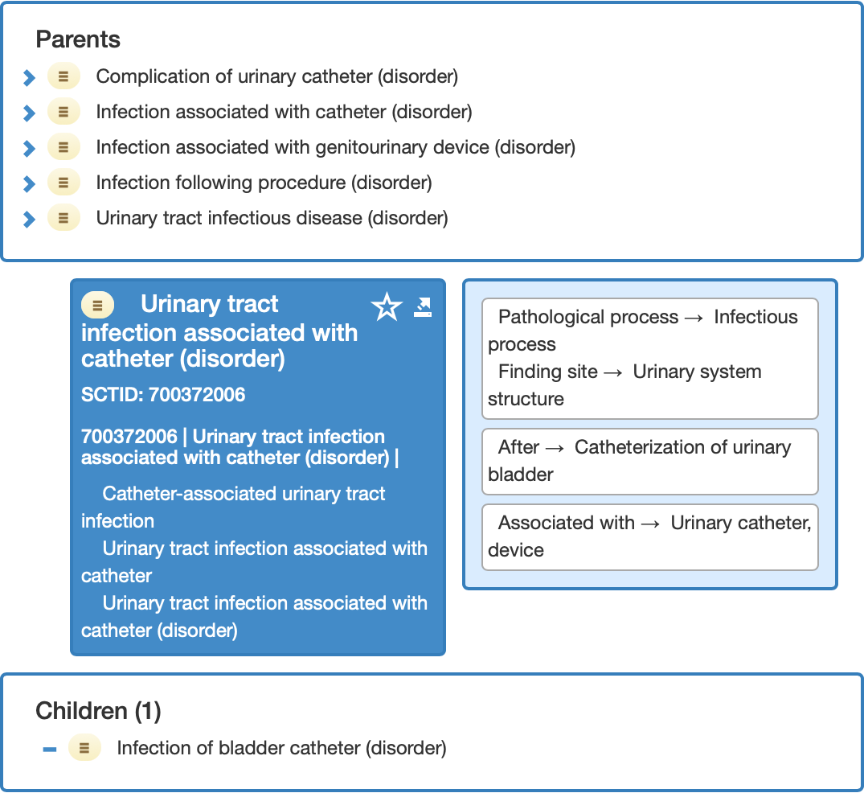
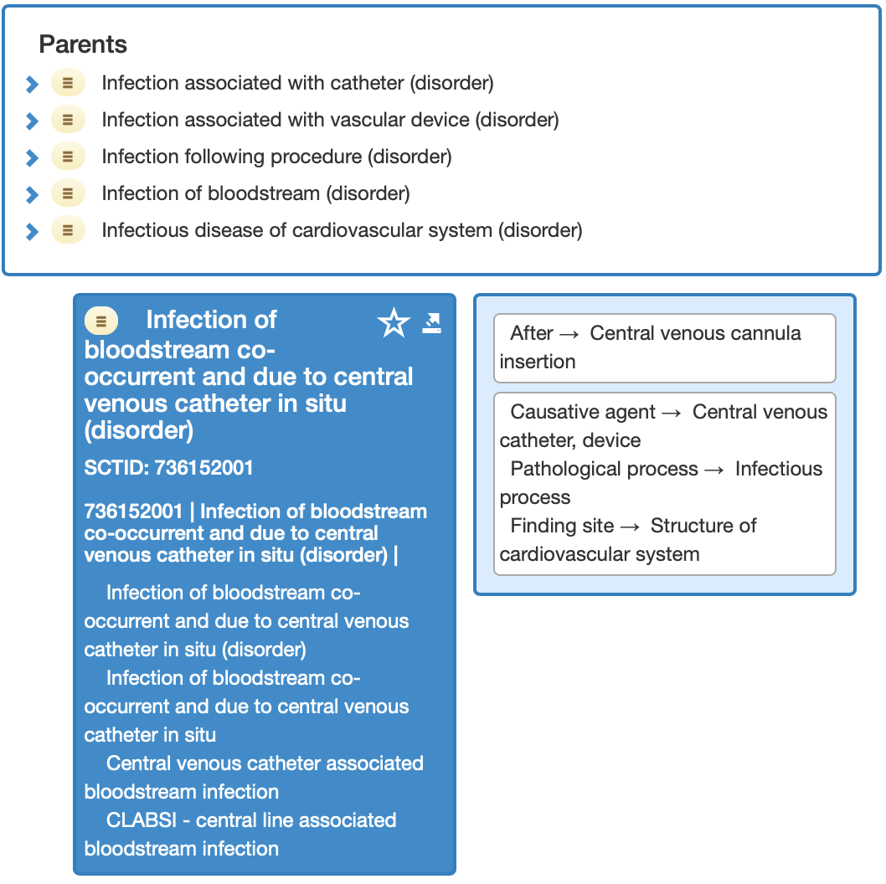
HCAI: diagnosis-based EHR

Slide 20
HCAI: diagnosis-based EHR
Challenges / scope of work:
Correctly identify HCAI cases
Use admission dates / previous admissions to determine healthcare association
Use procedures (e.g., insertion of central venous catheter) to identify device-associated infections – removal does not get documented
Use free-text notes (when available) to validate case identification

Slide 21
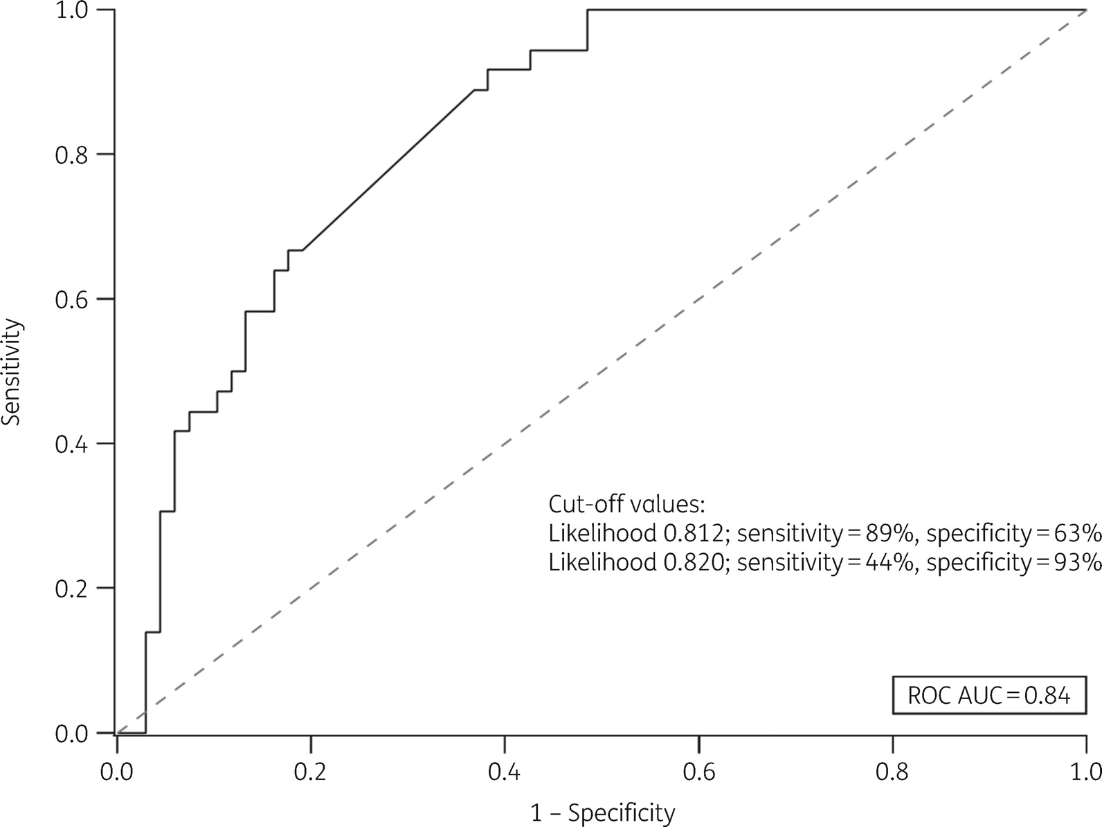


HCAI: diagnosis-based EHR with pathology
Six blood parameters (CRP, WBC, bilirubin, creatinine, ALT and alkaline phosphatase) were used in the model.
Mean likelihood estimates for those with and without infection were significantly different. The infection group had a likelihood of 0.80 and the non-infection group 0.50.
Rawson, JAC, 2018

Slide 22
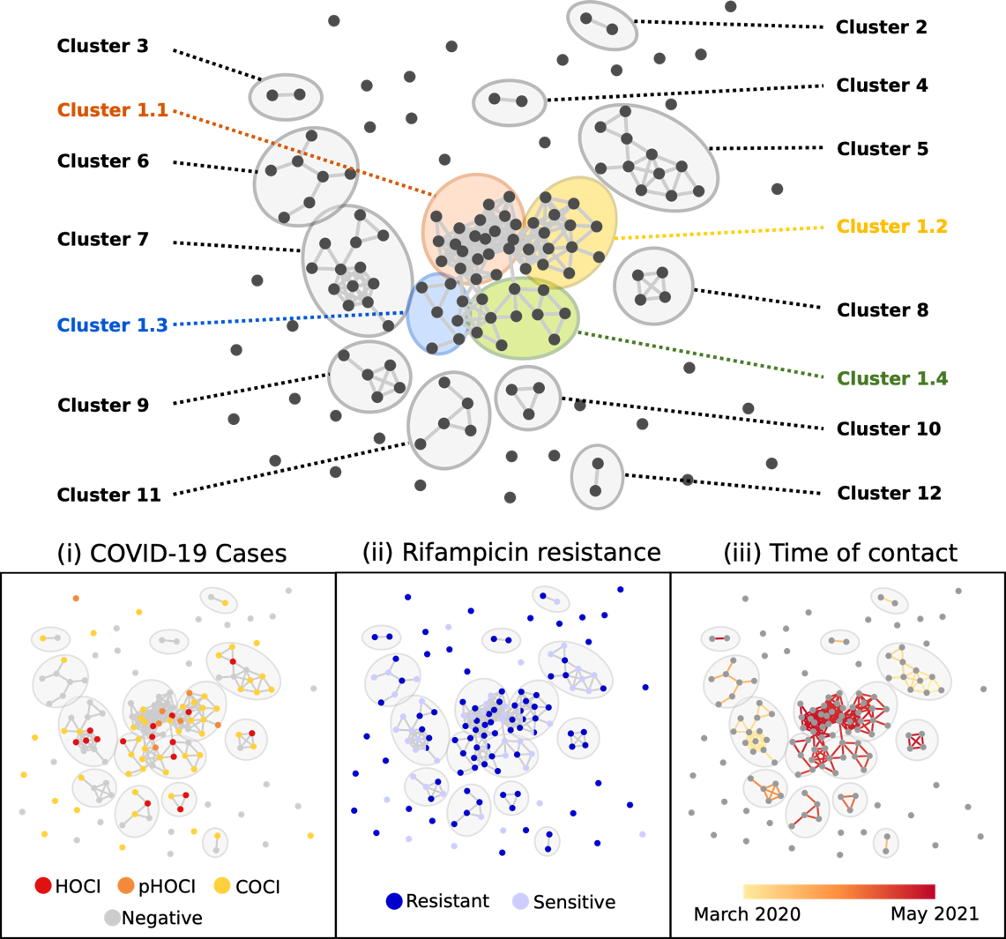


HCAI: diagnosis-based EHR with microbiology
All 17 BSI cases would be considered blood contaminants if following the current case criteria.
Reconstruction of patient contacts can be used to identify outbreaks of different pathogens.
Myall, Zhu, Jauneikaite, unpublished data

Slide 23
HCAI: diagnosis-based EHR
Challenges / scope of work:
Risk prediction using pathology data: infection acquisition, treatment response
Re-visit case criteria to determine true infections / clinically relevant infections

Slide 24

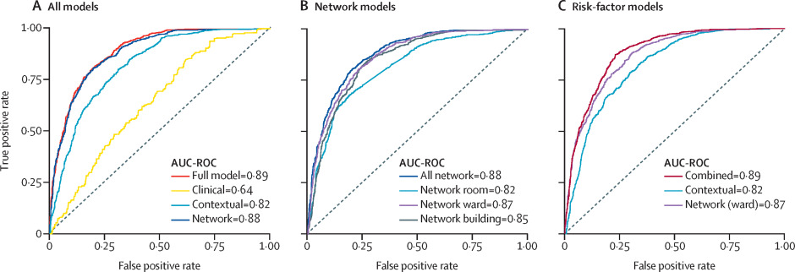
HCAI: risk prediction
The framework was highly predictive across test data with all variable types (AUC-ROC 0.89) and similarly predictive using only contact-network variables (0.88). Prediction was reduced when using only hospital contextual (0.82) or patient clinical (0.64) variables.
A model with only 3 variables (network closeness, direct contacts with infectious patients, and hospital prevalence) achieved AUC-ROC of 0.85.
Myall, Lancet Digital Health, 2022

Slide 25
Enhance HCAI surveillance and risk prediction
Standardisation
Expansion
Zhu, SSRN, 2021
Notes:
Expert consensus in the importance and feasibility, will revisit later

Slide 26
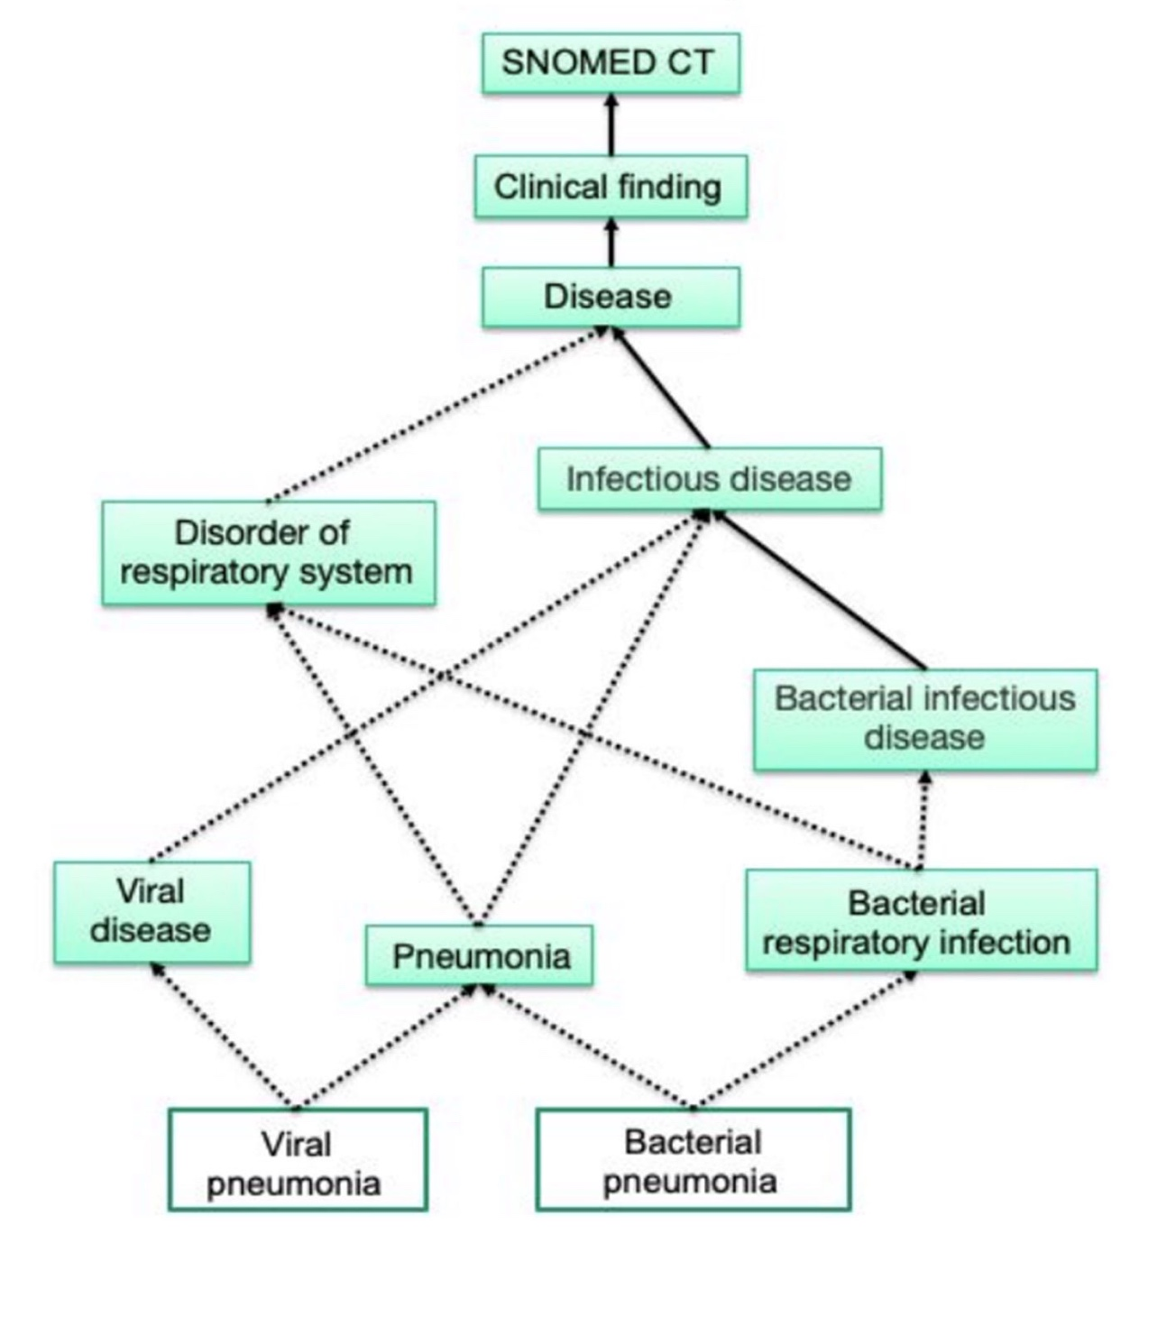
Community: case identification
Tiered approach based on what is commonly included in primary care records:
Coded diagnosis
Diagnosis derived from tests
Observations / complaints
Prescriptions

Slide 27
Community: case identification
Challenges / scope of work:
Correctly identify community-acquired cases
Look for either order of tests or test results to confirm whether diagnostics were performed
Use antibiotic history and hospital admission to determine healthcare association

Slide 28
Across all sectors: address health inequalities
Challenges / scope of work:
people with multiple long-term health conditions and polypharmacy
young carers, looked after children or care leavers
care home residents
residents in overcrowded households
inclusion health groups (homeless, drug and alcohol dependent, Roma / Gypsy / traveller communities, sex workers, migrants, people in contact with justice systems and victims of modern slavery) - normally with limited data
Notes:
; including electronic patient records and hospital bed occupancy

Slide 29
Across all sectors: the economic burden of AMR
Item-based micro-costing
Healthcare resource group-based micro-costing

Slide 30
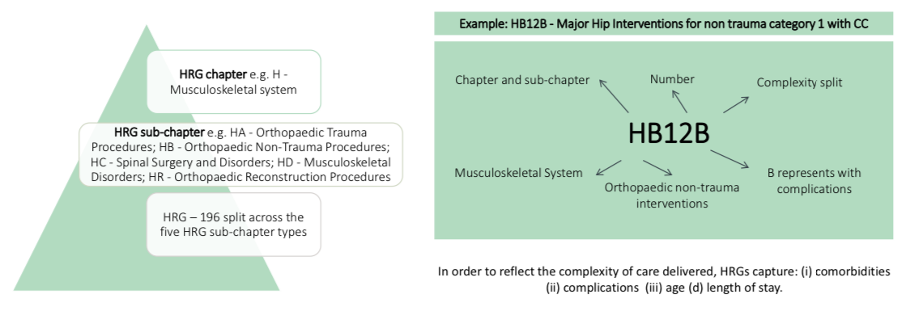
What is Healthcare Resource Group
A HRG is a set of diagnoses or procedures which are similar in terms of care delivered and resource use

Slide 31
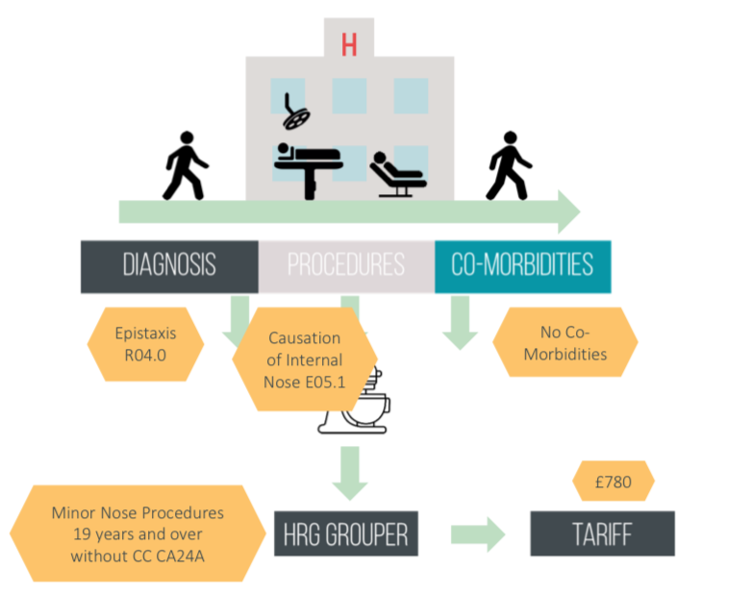
How a tariff is set
Cost: national average
Currency
Efficiency: to adjust for the gap between commissioner funding allocation and supplier cost

Slide 32
Across all sectors: the economic burden of AMR
Challenges / scope of work:
consistently defined comparators: AMR vs no AMR
elements / items to cost
time horizon
in-direct medical costs
loss of medical workforce due to transmission
Notes:
; including electronic patient records and hospital bed occupancy

Slide 33
Messages
Data linkage and integration is the way forward.
At CAMO-Net UK, our goal is to develop feasible, contextually fit methods to support curation, processing, linkage, and analysis of data for all partner institutes and countries.
Technological and ethical considerations? Our activity
Notes:
Standardisation – here we mapped the reporting metrics of the main HCAI surveillance networks and see variations
The diagnostics and case definitions also are inconsistent
Additionally, we want to move away from replying on blood cultures and adopt new diagnostics (like the microneedles).

Slide 34
Overview
Welcome
Data linkage: why, how, what to achieve within CAMO-Net
Ongoing work in CAMO-Net UK
Activity
Notes:
; including electronic patient records and hospital bed occupancy

Slide 35
Activity
What data do you have in primary and secondary care
Level of linkage: within one hospital, multiple hospitals, hospitals and primary care)
Coverage: regional / sub-national, national, international
Types of data: diagnoses, laboratory, prescribing
Data pre-processing: clinical vocabulary / codes vs free-text
Who are the data controllers
Governance mechanism
Notes:
Standardisation – here we mapped the reporting metrics of the main HCAI surveillance networks and see variations
The diagnostics and case definitions also are inconsistent
Additionally, we want to move away from replying on blood cultures and adopt new diagnostics (like the microneedles).

